Slide 1
Linwood Place Spring general meeting
Rain barrels
By Craig miller

Slide 2
Rain barrels and water collection
1 inch of rain on 1000 sq ft of roof will net 600 gallons of water
Ideal for watering indoor/outdoor plants
Lessens the amount of storm runoff in the streets
Can also be used to collect the condensate from your Air conditioning system

Slide 3
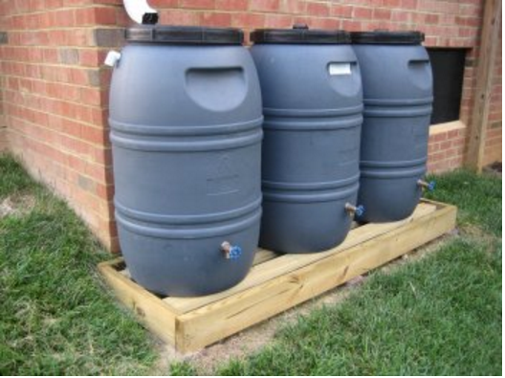
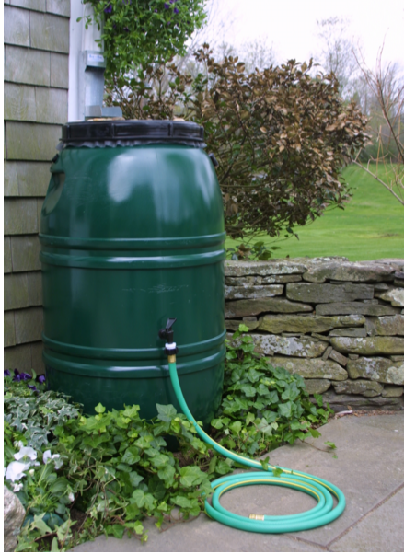
Things to consider
Rain barrel location
Away from basements, unless adequate overflow system is created
Out of sight?
Orientation
Bank of rain barrels
Single rain barrel under a downspout
Placement
On the ground
elevated

Slide 4
Supplies (barrels)
Where to get rain barrels in OKC
Craigslist
Least expensive ~$20-40 per barrel
Require more work, setup is diy
Upcycle products
Cost is slightly higher @ $64 per barrel
Barrels come with all hardware attached
Multiple color selections
Orders are placed through the company and picked up at the public works on s. Portland
Online order deadline is June 12th

Slide 5
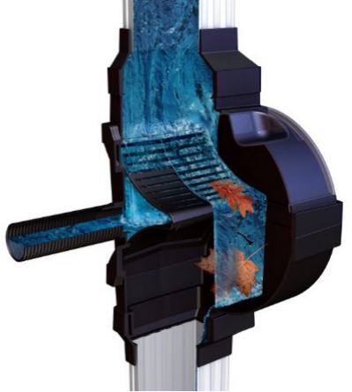
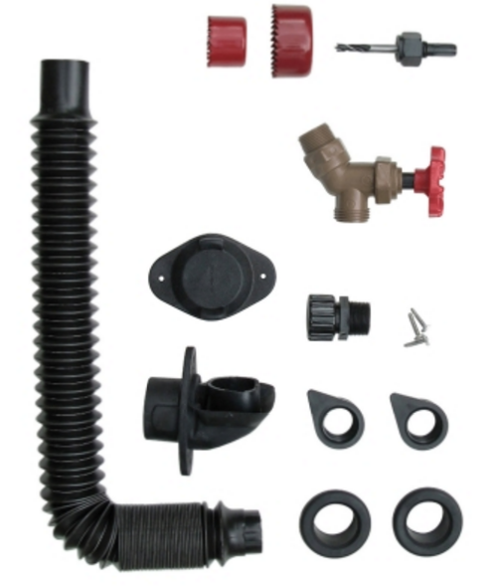
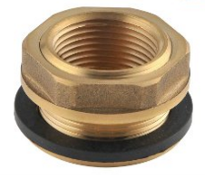
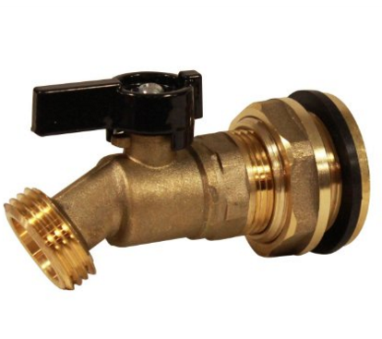
Supplies (hardware)
Downspout diverter
Spigot
Overflow
Linking hoses (for barrel banks)
Mesh screen for debris and mosquito control
Barrel conversion kits

Slide 6
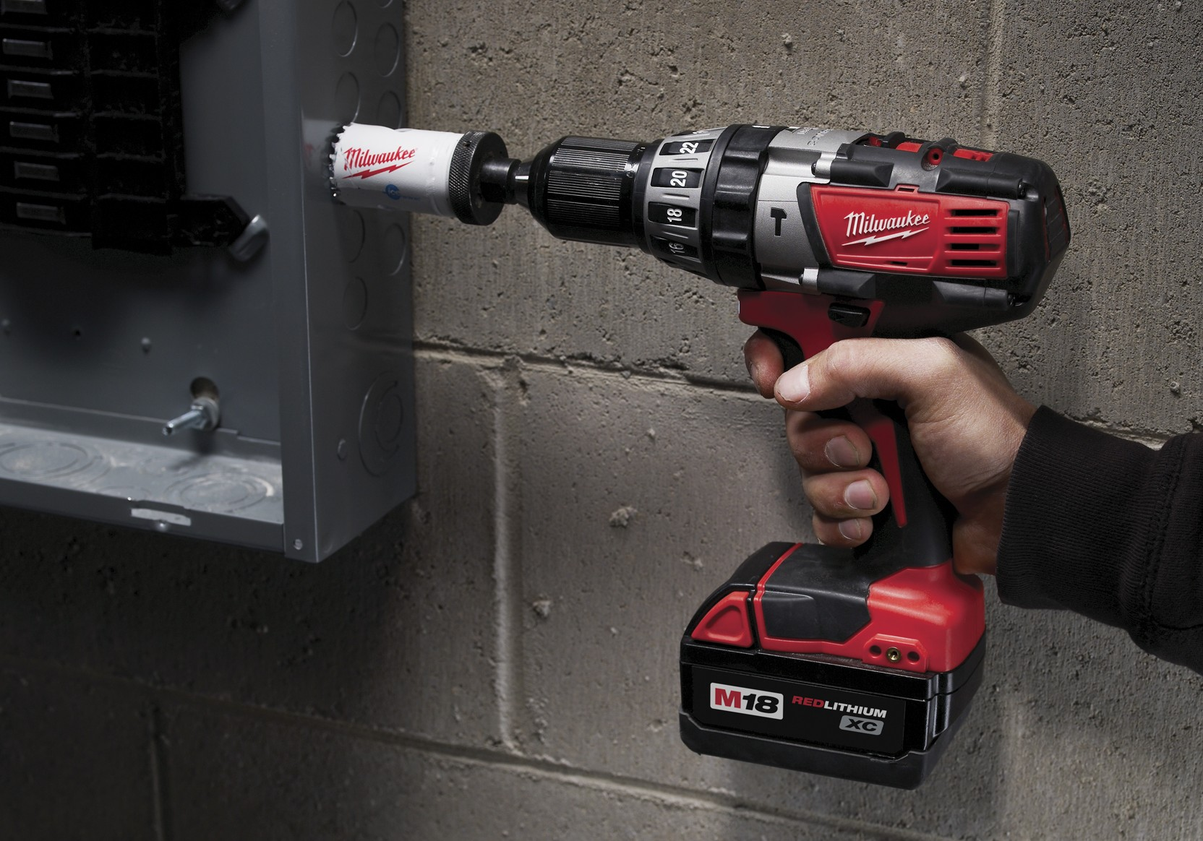
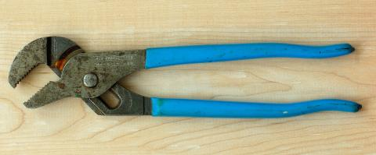
Supplies (tools)
Drill
Hole saw
Channel lock pliers
Small hand saw
For barrels with permanently fixed lids

Slide 7
Assembly
Overall assembly will vary greatly based upon hardware selected
Elevate the spigot enough to be able to attach a hose
Around 6” for barrels that are on the ground
As low as achievable for barrels that are elevated
Carefully consider the location of the ports for linking systems
Better If linked at the bottom
the barrels have more time to level during a downpour
Only one spigot needed for draining the barrels

Slide 8
Mosquito control
Mosquitoes will breed in the rain barrels if they are not adequately protected
Mosquito control options
Screens
Set it and forget it
Easy to build
BTI
A bacteria that is put into the water and only kills mosquitoes, gnats, and blackflies
Comes in multiple forms (liquid, granules, or dunks)
Must reapply according to manufacturer’s recommendations
Fish
Goldfish, guppies, and mosquito fish are all known for eating mosquito larva
Must supplement their diet in non-mosquito season and provide a place for them to live in the winter
Rain barrel must be out of the sun, as the temperature of the water can become too warm

Slide 9
Resources
Upcycle products :
http://www.upcycle-products.com/static.asp?path=6216
Okc utilities department water conservation website:
http://squeezeeverydrop.com/Home.aspx
Rain barrel tutorial:
http://squeezeeverydrop.com/SavingWaterOutdoors/RainBarrels.aspx
Brass hardware specifically for rain barrels
http://www.amazon.com/s/ref=nb_sb_noss_1?url=search-alias%3Dlawngarden&field-keywords=rainpro

